Slide 1
Finding an Optimal Hypervisor Location for the GÉANT Network
David Hamblin

Slide 2
Outline
Introduction
Background
Mathematical Model
Implementation
Results
Conclusion

Slide 3

Introduction
Evaluating the GÉANT network for optimal hypervisor placement
Using the mathematical models from the paper “Pairing SDN with Network Virtualization: The Network Hypervisor Placement Problem”
Implementation in Gurobi and through exhaustive search

Slide 4
Background
GÉANT is a network spanning Europe, interconnecting national research and educational networks
The primary network for the research and education community
Over 1 Petabyte of data are transferred every day
Goal is to find the optimal location of a hypervisor to interconnect virtual nodes with the lowest latency cost based on location
Assumes that all link speeds are the same, and latency is dependent upon the length of each link

Slide 5
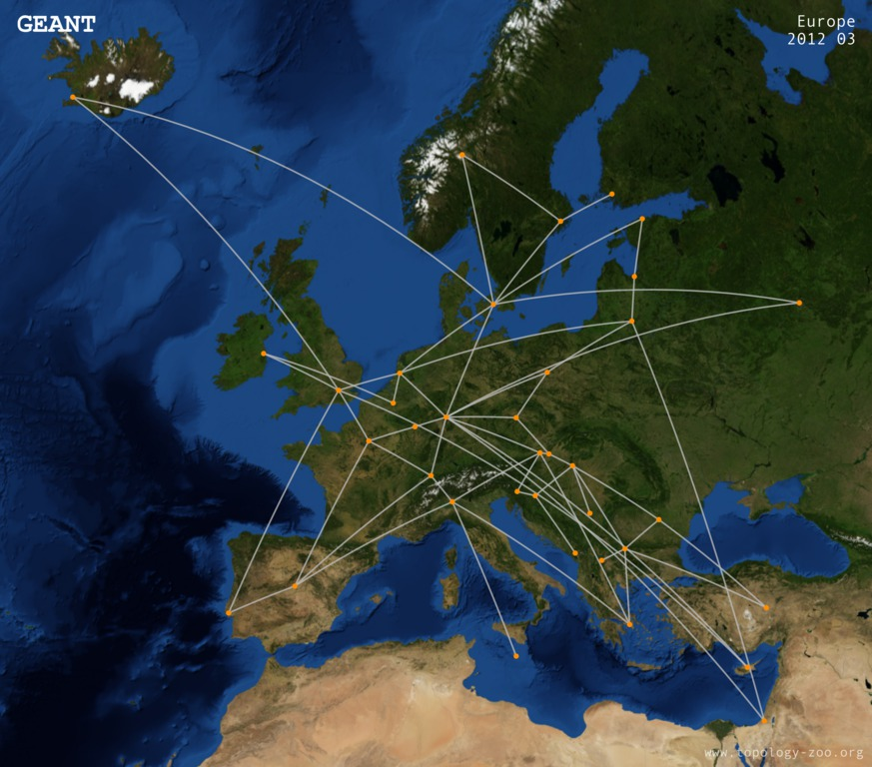
GÉANT Network

Slide 6
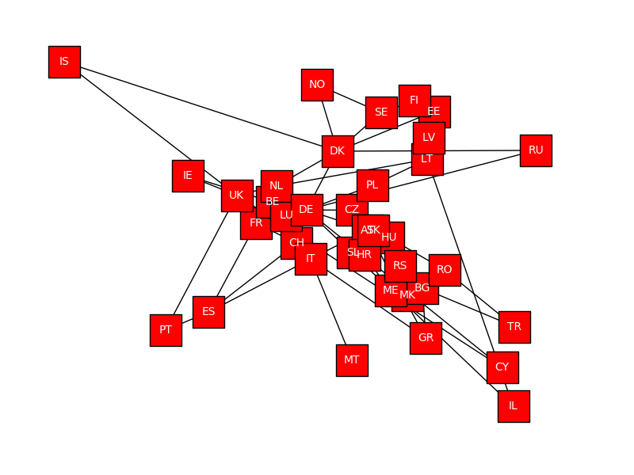
GÉANT Network

Slide 7
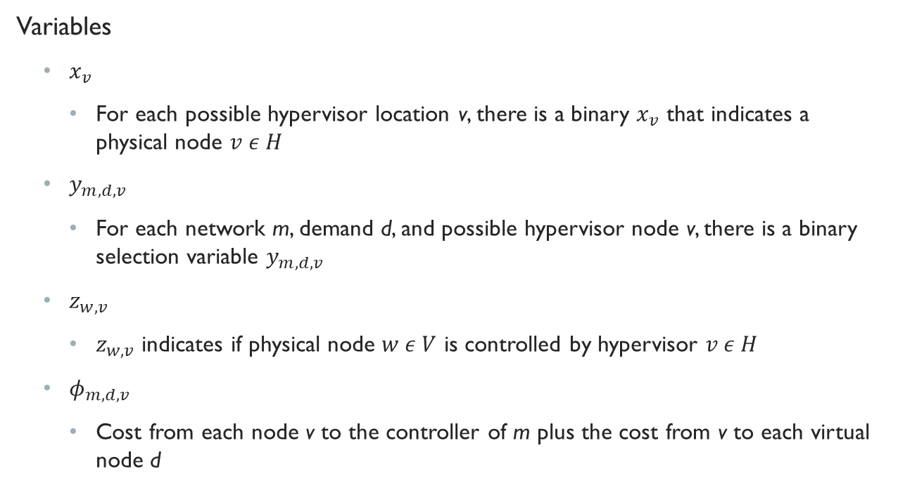
Mathematical Model
Variables
$x_{v}$
For each possible hypervisor location v, there is a binary $x_{v}$ that indicates a physical node $v ε H$
$y_{m,d,v}$
For each network m, demand d, and possible hypervisor node v, there is a binary selection variable $y_{m,d,v}$
$z_{w,v}$
$z_{w,v}$ indicates if physical node $w ε V$ is controlled by hypervisor $v ε H$
$φ_{m,d,v}$
Cost from each node v to the controller of m plus the cost from v to each virtual node d

Slide 8
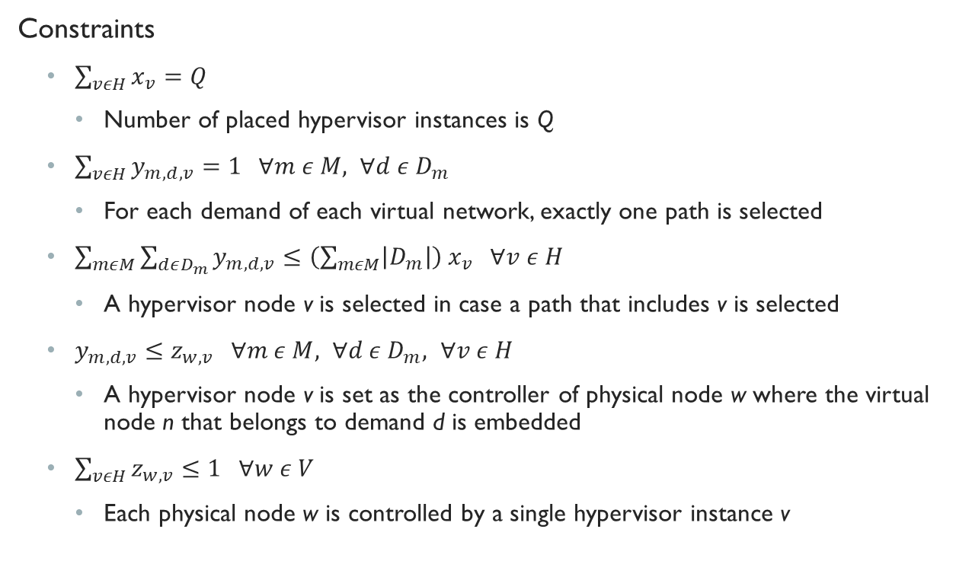
Mathematical Model
Constraints
$\sum_{vεH}{x_{v}}=Q$
Number of placed hypervisor instances is Q
$\sum_{vεH}{y_{m,d,v}}=1 ∀m ε M, ∀d ε D_{m}$
For each demand of each virtual network, exactly one path is selected
$\sum_{mεM}{\sum_{dεD_{m}}{y_{m,d,v}}}≤\left(\sum_{mεM}{\left|D_{m}\right|}\right){ x}_{v} ∀v ε H$
A hypervisor node v is selected in case a path that includes v is selected
$y_{m,d,v}≤z_{w,v} ∀m ε M, ∀d ε D_{m}, ∀v ε H$
A hypervisor node v is set as the controller of physical node w where the virtual node n that belongs to demand d is embedded
$\sum_{vεH}{z_{w,v}}≤1 ∀w ε V$
Each physical node w is controlled by a single hypervisor instance v

Slide 9
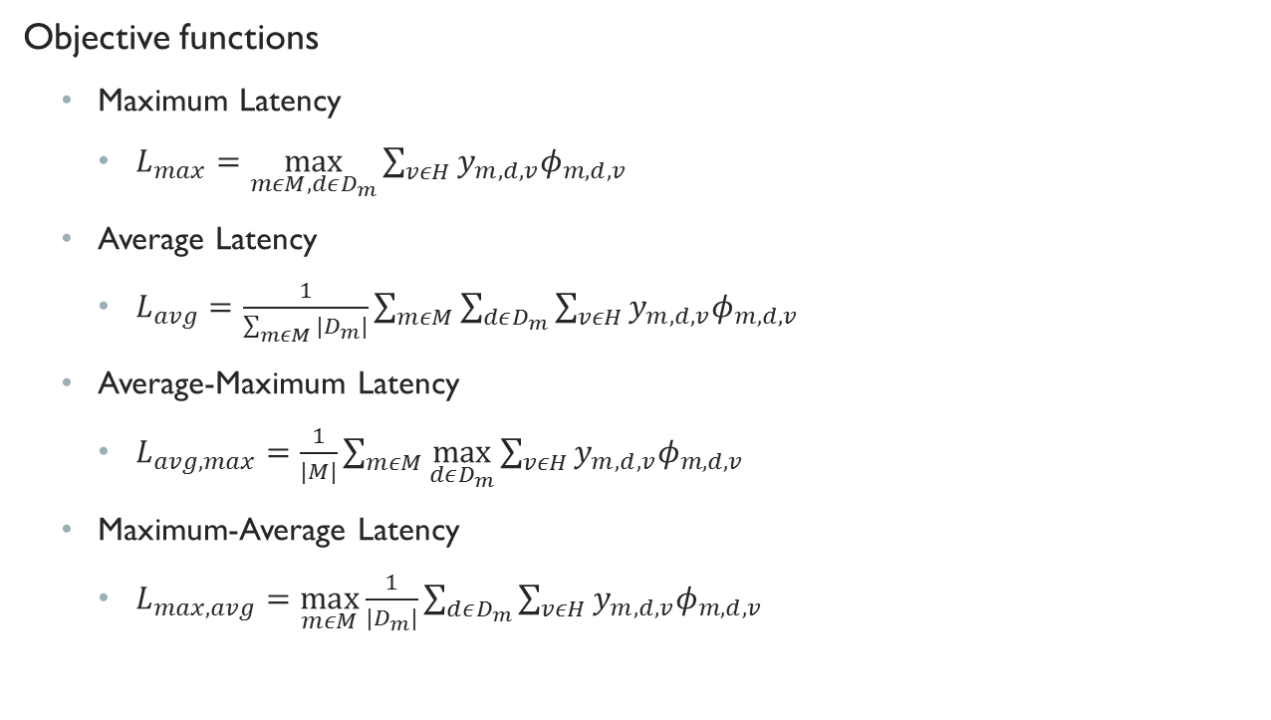
Mathematical Model
Objective functions
Maximum Latency
$L_{max}=\max_{mεM, dεD_{m}}{\sum_{vεH}{y_{m,d,v}φ_{m,d,v}}}$
Average Latency
$L_{avg}=\frac{1}{\sum_{mεM}{|D_{m}|}}\sum_{mεM}{\sum_{dεD_{m}}{\sum_{vεH}{y_{m,d,v}φ_{m,d,v}}}}$
Average-Maximum Latency
$L_{avg,max}=\frac{1}{|M|}\sum_{mεM}{\max_{dεD_{m}}{\sum_{vεH}{y_{m,d,v}φ_{m,d,v}}}}$
Maximum-Average Latency
$L_{max,avg}=\max_{mεM}\frac{1}{|D_{m}|}\sum_{dεD_{m}}{\sum_{vεH}{y_{m,d,v}φ_{m,d,v}}}$

Slide 10
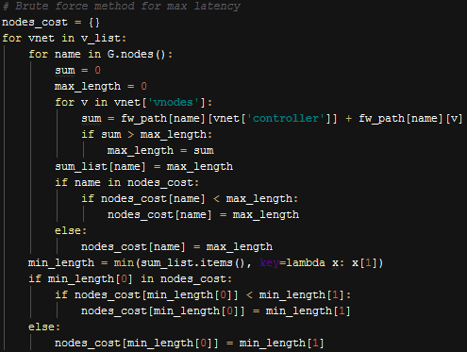
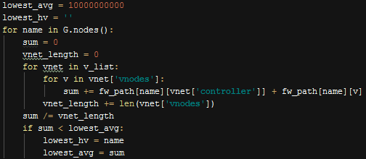
Implementation (Exhaustive Search)
Iterating through each node in the substrate network G, each network M, and each demand (virtual node) in D_{m}, to find the values for each objective function
Each is specifically tailored to the function it wants to minimize
E.g. Maximum Latency and Average Latency

Slide 11
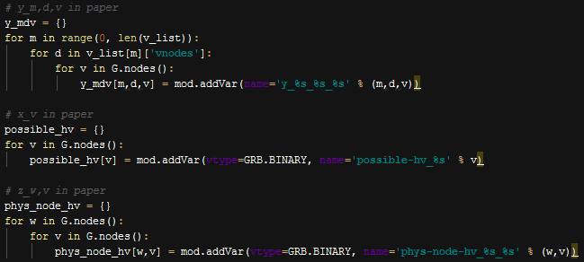
Implementation (Gurobi)
Each variable is added as

Slide 12
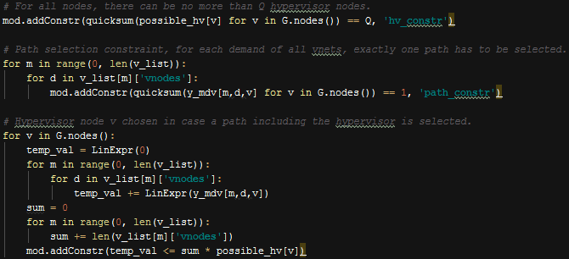
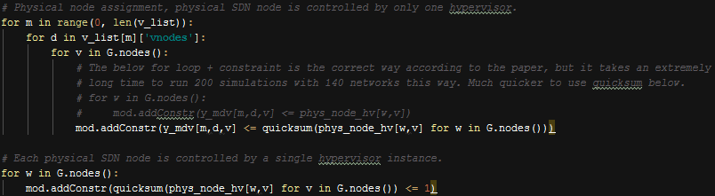
Implementation (Gurobi)
Each constraint is added as

Slide 13
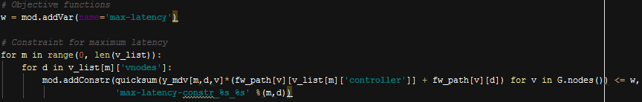

Implementation (Gurobi)
Each objective function is added like
And the model is optimized by running

Slide 14
Advantages/Disadvantages
Exhaustive Search
Faster runtime, does not require building a full Gurobi model – also free
Sometimes requires complete rework for different objective functions
Adding multiple hypervisors requires overhaul of code
Gurobi
Easy to adapt to new objective functions, or changing variables/constraints
Designed for linear programming problems, find solutions through parallel execution

Slide 15
Results
The optimizer is executed 200 times for three different amounts of total networks, and with placement of one hypervisor
For 10 networks, 50 networks, and 100 networks
Each network has 2…10 virtual nodes and one controller – selected randomly

Slide 16
Results
10 Virtual Networks, 200 Simulations
Max Latency Overall: {'DE': 142, 'NL': 25, 'CH': 7, 'HU': 6, 'AT': 6, 'SK': 5, 'UK': 3, 'LT': 3, 'LU': 2, 'FR': 1}
Average Latency Overall: {'DE': 166, 'AT': 26, 'CZ': 7, 'SK': 1}
Average-Max Latency Overall: {'DE': 193, 'AT': 4, 'CZ': 2, 'NL': 1}
Max-Average Latency Overall: {'DE': 134, 'NL': 12, 'AT': 11, 'CZ': 11, 'CH': 8, 'LU': 7, 'UK': 6, 'FR': 3, 'SK': 3, 'DK': 2, 'LT': 2, 'HU': 1}
50 Virtual Networks, 200 Simulations
Max Latency Overall: {'DE': 183, ‘NL': 17}
Average Latency Overall: {'DE': 197, 'AT': 3}
Average-Max Latency Overall: {'DE': 197, 'LU': 2, 'CZ': 1}
Max-Average Latency Overall: {'DE': 194, 'LU': 2, 'AT': 2, 'NL': 2}
100 Virtual Networks, 200 Simulations
Max Latency Overall: {'DE': 200}
Average Latency Overall: {'DE': 200}
Average-Max Latency Overall: {'DE': 174, 'LU': 21, 'CZ': 5}
Max-Average Latency Overall: {'DE': 193, 'LU': 5, 'NL': 1, 'UK': 1}

Slide 17
RESULTS
In all cases and scenarios, Germany (DE) is the ideal location for a hypervisor
Max and average latency eventually become entirely Germany as number of networks increases in each scenario
Average-max and max-average latency are not entirely Germany, Luxembourg (LU) and the Czech Republic (CZ) pop up in each scenario
From 50 to 100 networks, average-max latency moves away from Germany and adds more Luxembourg/Czech Republic

Slide 18
Conclusion + Outlook
Regardless of the metric, Germany is ultimately considered the best location
It is in the center of the network with the most connections
Exhaustive search executes the code with a single hypervisor very quickly, although Gurobi allows for easier configuration of variables, constraints
Providing a weight to a link’s cost as link speed, as opposed to just using length, would allow for more accurate results
Implementing multiple hypervisors could decrease the overall cost for the networks
Would require install cost for hypervisor as well to prevent adding as many as there are nodes
So...

Slide 19
GÉANT with Multiple Hypervisors
Two hypervisors
By placing two, one is almost always placed at Germany, while the others have equal share concentrated around the nodes in Austria, United Kingdom, Netherlands, Hungary, and Slovakia to maximize two sides of the network
Three hypervisors
Similar to two hypervisors, although we see Latvia and Hungary with almost as much presence as Germany in max and average, and the same results for max-average and average-max as with two hypervisors
Four hypervisors
For max latency, Israel appears more often than Germany, with similar results from three hypervisors for the other objective functions
Overall
Cost typically decreases by only a minor amount for each case, due to the relatively small size of the network, until it plateaus. This is due to having only one controller to route to and limited options to get there
(without having link speeds, I couldn’t really gather results for that part)

Slide 20
Questions? (Dr. RIEDL)

